Slide 1
Week 8 Presentation
Solutions for Prevent Cancer Foundation
Professor: Abou Tabl
Group 1: Swati Lalwani, Duong Thai Le,Padma Ammagoth

Slide 2
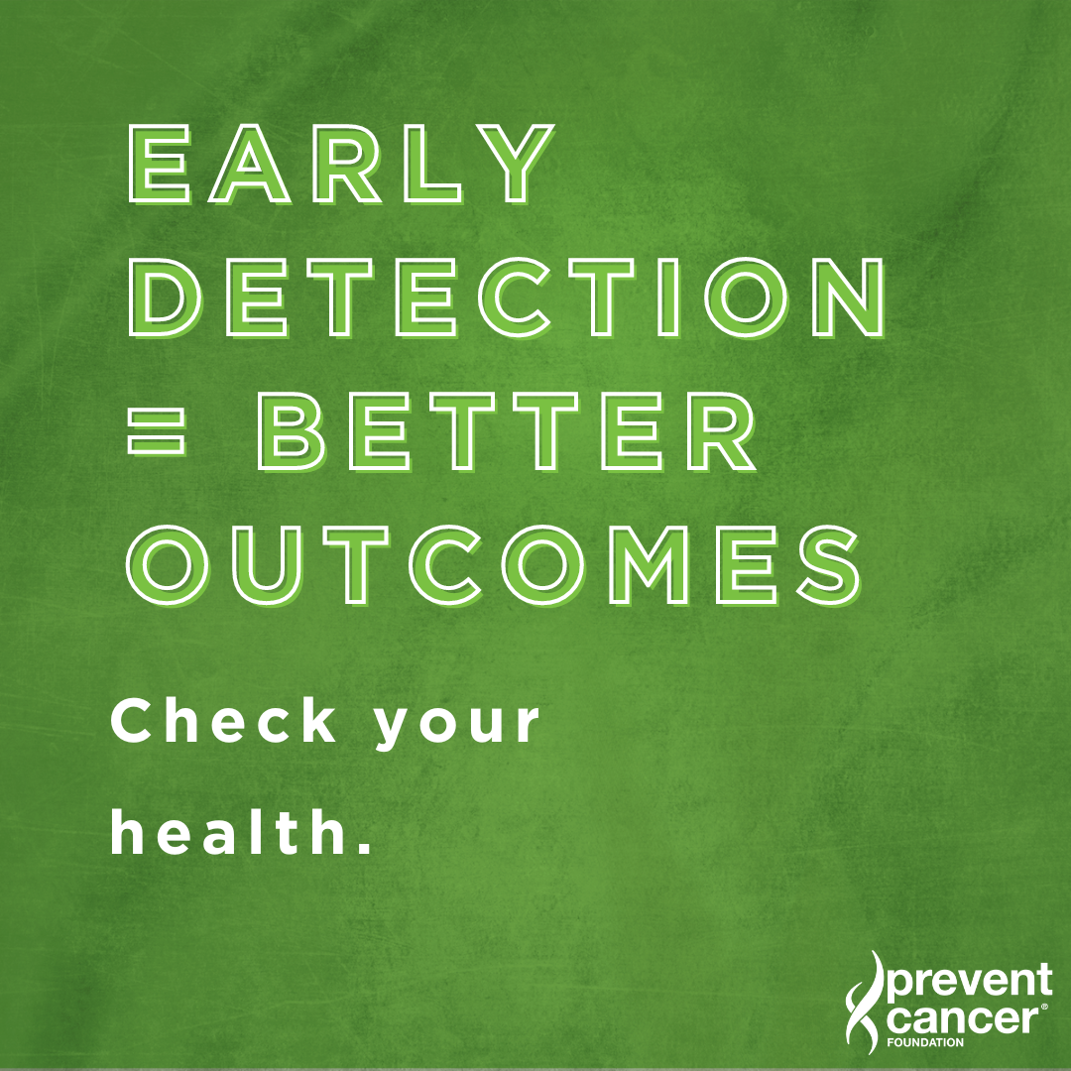
Introduction
About Prevent Cancer Foundation
Goal of Using AI
Early detection
Preventive measures
Overall survival rate

Slide 3
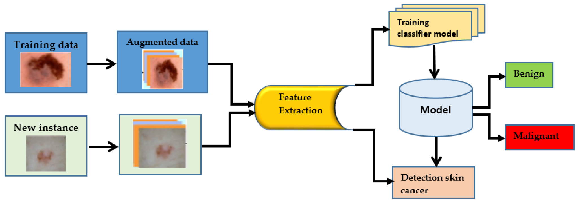
Services and Justification
Predictive Analysis
Machine Learning Algorithms
Awareness programs
Prescription
Monitoring solutions
Predictive analysis over prescriptive analysis

Slide 4


Examples of other Non Profit Organizations
BCRF Organization
Goals of BCRF
Use of AI in Early cancer Detection
Preventive measures
American Cancer Society
Goals of ACS
Lifestyle awareness

Slide 5
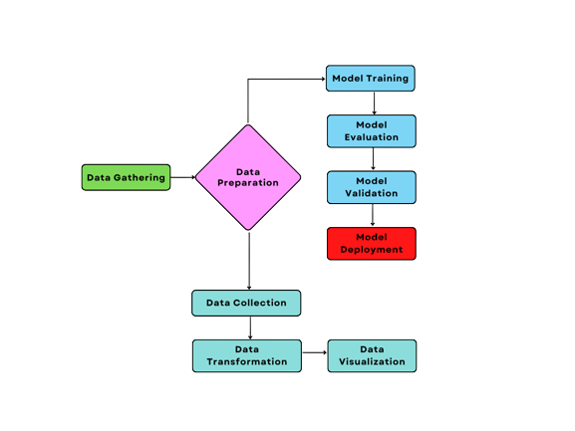
Outline
Predictive Analytics: The application of predictive analytics in breast cancer prevention offers significant potential to enhance early detection, personalize risk assessment, and guide targeted interventions.
The key steps involved in applying predictive analytics:
Problem Definition
Data collection
Data preparation
Exploratory Data Analysis
Model Selection
Model Training
Model Evaluation
Deployment
Monitoring and Maintenance

Slide 6
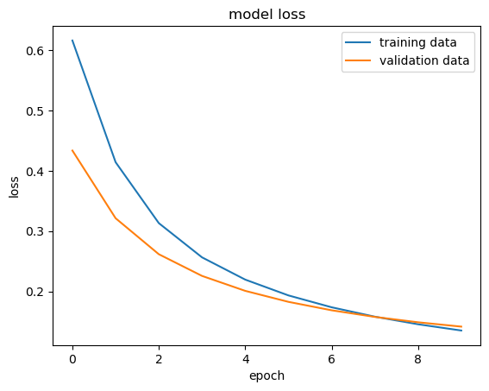
Model training and prediction
Developed and deployed a breast cancer detection model using Snowflake for data ingestion and TensorFlow for machine learning, achieving 95.30% accuracy on test data by training a neural network with 30 features after data preprocessing and standardization.
Performed exploratory data analysis (EDA) and feature engineering on a Kaggle dataset to identify key patterns and correlations, improving model performance by reducing multicollinearity and addressing class imbalance in the dataset.

Slide 7
Visualizations
Visual representations are indispensable in cancer prevention, as they make complex information more accessible, enhance communication between patients and healthcare providers, and support more informed, data-driven decision-making.
Risk Stratification: Risk stratification chart or a heatmap
Patient Risk Score Visualization: Personalized risk dashboard or gauge chart
Model Performance Evaluation: ROC curves, confusion matrices, and precision-recall curves
Feature Importance Visualization: Feature importance charts(e.g., bar graphs or SHAP value plots)
Temporal Risk Prediction: Time series plots or survival curves
Population-Level Insights: Geographic heatmaps or cluster analysis maps
Scenario Analysis and Decision Support: Decision trees or what-if scenario charts
Model Monitoring and Feedback: Performance dashboards

Slide 8
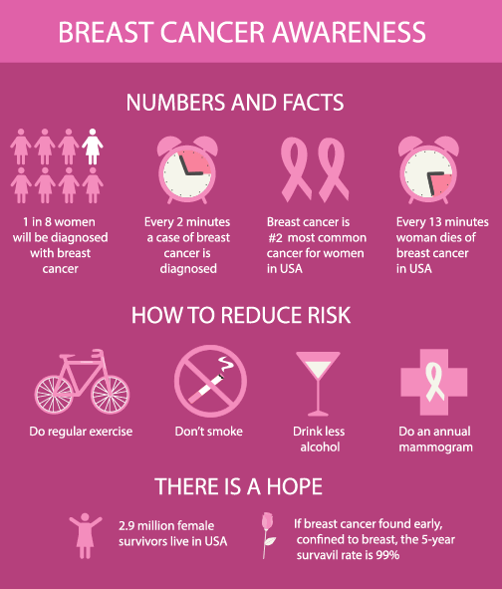
Limitations
Data accuracy
Data completeness
Model precision
Costs of genetic testing
Following preventive strategies

Slide 9
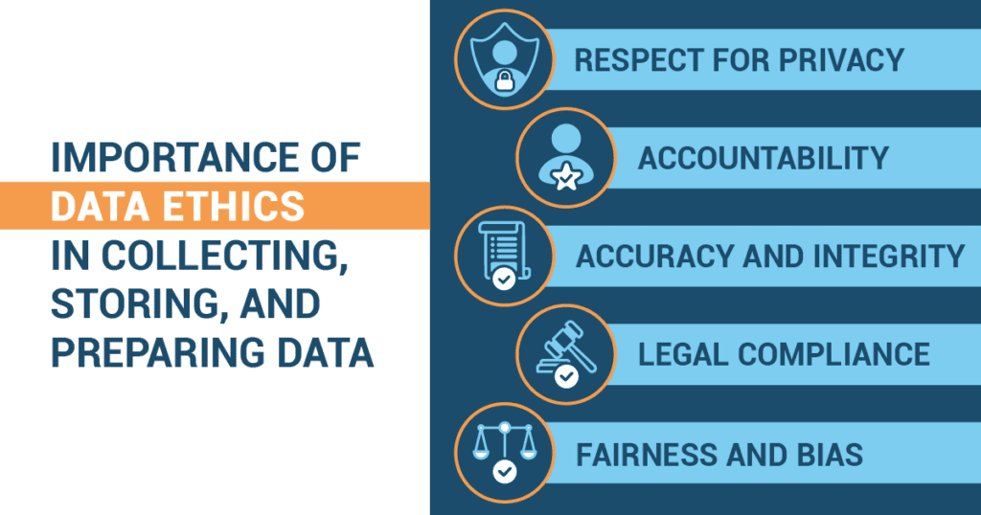
Legal & Ethical Concerns
Obtaining consent
Data privacy and security
Biases
Misuse of data

Slide 10
References
American Cancer Society. (2024). About the American Cancer Society. https://www.cancer.org/
American Society of Clinical Oncology [ASCO]. (2023). Big data and analytics in oncology: Transforming cancer care. https://ascopubs.org/doi/10.1200/JCO.2023.41.16_suppl.6513
Baum, M. L., et al. (2021). Informed consent and privacy in data collection: Ethical perspectives. Journal of Medical Ethics, 47(4), 256-262.
Bcrf. (2024, April 24). Ai and personalized breast cancer care. Breast Cancer Research Foundation. https://www.bcrf.org/blog/ai-predictive-analytics-precision-medicine-breast-cancer/
Bcrf. (2024b, April 26). Ai Breast Cancer Detection and diagnosis. Breast Cancer Research Foundation. https://www.bcrf.org/blog/ai-breast-cancer-detection-screening/
Keenan, P. (2020). Health data privacy laws: The intersection of HIPAA and technology. Health Affairs, 39(3), 431-437.
Mostavi, M., et al. (2020). The role of machine learning in cancer prediction and early detection. Frontiers in Oncology, 10, 177.
Obermeyer, Z., Powers, B., Vogeli, C., & Mullainathan, S. (2019). Dissecting racial bias in an algorithm used to manage the health of populations. Science, 366(6464), 447-453.
Parikh, R. B., Obermeyer, Z., & Navathe, A. S. (2019). Regulation of predictive analytics in medicine. Science, 363(6429), 810-812.
Prevent Cancer Foundation. (2024b, June 25). Prevent cancer foundation research grants & fellowships. Prevent Cancer Foundation. https://preventcancer.org/research/
Richards, N. M., & King, J. H. (2014). Big data ethics. Wake Forest Law Review, 49(2), 393-432.

